Slide 1

Internship project
Machine Downtime Optimization

Slide 2

Project Leadership
Sharat Manikonda
Director at Innodatatics and Sponsor
linkedin.com/in/sharat-chandra

Slide 3
Team Members
Name: Manakavoo siva balaji
https://www.linkedin.com/in/manakavoo-siva-balaji-a-3b846b230/

Slide 4

Contents
Business objective
Business Constraints
Project Architecture
Data collection and details
Exploratory Data Analysis
Visualization
Modeling
Evaluation
Deployment
Notes:
Change

Slide 5
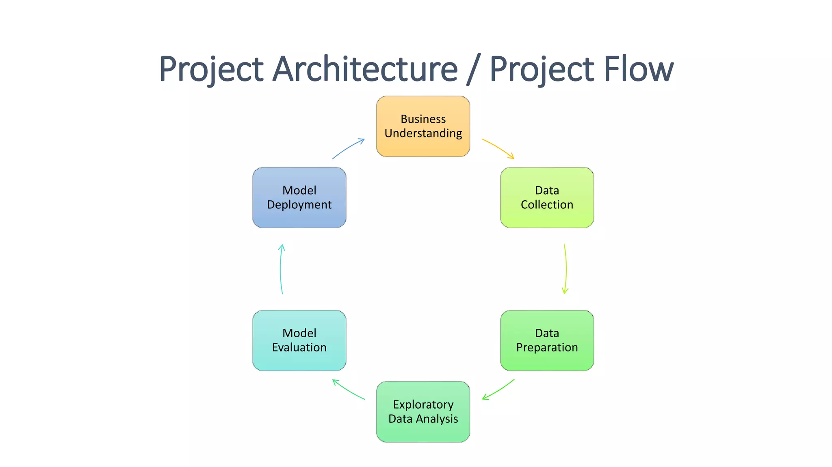
Project Overview and Scope

Slide 6
Business Problem
A company manufacturing fuel pumps faces uncertain downtime, affecting profitability and customer satisfaction. This disruption disrupts production flow, resulting in wasted resources and reduced output.
To address this issue, the company must identify root causes, implement effective solutions, and promote efficient production processes, proactive maintenance, resource utilization, and timely problem resolution.

Slide 7
Business Objective
Objective
Constraints
Limited financial resources require prioritization and cost-effective solutions for downtime reduction.
To reduce the likelihood of downtime and increase production flow

Slide 8
CRISP-ML(Q) Methodology
There are six stages of CRISP-ML(Q) Methodology
1.Business and data understanding
2.Data preparation
3.model building
4.Model evaluation
5.Model deployment
6.Monitoring and maintenance

Slide 9
Technical Stacks
Industrial Internet of Things (IIoT) Platform: Implementing an IIoT platform enables data collection from sensors and equipment on the production floor as well as real-time monitoring.
This enables predictive maintenance to decrease downtime, track machine health, and spot anomalies.
Siemens Mind Sphere, AWS IoT Core, and Microsoft Azure IoT are a few well-known IIoT platforms.
Data analytics and machine learning: Making use of these approaches can improve production procedures and offer insightful information about the causes of downtime.
Utilizing cloud computing services, such those from Microsoft Azure or Amazon Web Services (AWS), can offer scalable infrastructure for storing and processing massive volumes of data.

Slide 10
Data Collection and Understanding
Select the data collection techniques that will be most effective. Installing sensors, data loggers, or interfacing with already installed machine monitoring systems can all be part of this. Depending on the needs, data can be gathered periodically or in real-time.
Make that the data gathering methods are trustworthy, accurate, and suited to the frequency and level of detail required for analysis.

Slide 11
Data Information
Industrial Internet of Things (IIoT) Platform: Implementing an IIoT platform enables data collection from sensors and equipment on the production floor as well as real-time monitoring.
This enables predictive maintenance to decrease downtime, track machine health, and spot anomalies.
Data analytics and machine learning: Making use of these approaches can improve production procedures and offer insightful information about the causes of downtime.
The quality and relevance of data information are crucial for making accurate and informed decisions.
To ensure the reliability and validity of data information, it is essential to establish robust data collection and analysis processes, implement quality control measures, and validate the findings against real-world observations.

Slide 12
Data Dictionary

Slide 13
System Requirements

Slide 14
Exploratory Data Analysis [EDA]
Notes:
EDA is used for seeing what the data can tell us before the modeling task.
Change

Slide 15
Missing Values Observation

Slide 16
Data Preprocessing
Notes:
Keep observations

Slide 17
Data Preprocessing

Slide 18
Data Visualization
Notes:
Add graphical

Slide 19
Model Building
Notes:
classification is the task of predicting a discrete class label. Regression is the task of predicting a continuous quantity.
What is classification techniques in machine learning?
The Classification algorithm is a Supervised Learning technique that is used to identify the category of new observations on the basis of training data. In Classification, a program learns from the given dataset or observations and then classifies new observation into several classes or groups.
What is regression techniques in machine learning?
Regression is a technique for investigating the relationship between independent variables or features and a dependent variable or outcome. It's used as a method for predictive modeling in machine learning, in which an algorithm is used to predict continuous outcomes.

Slide 20
Model Accuracy Comparison

Slide 21
Best Model –
Notes:
Why Random Forest Regression is good?
A Random Forest Regression model is powerful and accurate. It usually performs great on many problems, including features with non-linear relationships
How is XGBoost different from random forest?
One of the most important differences between XG Boost and Random forest is that the XGBoost always gives more importance to functional space when reducing the cost of a model while Random Forest tries to give more preferences to hyperparameters to optimize the model..
n_estimators — the number of decision trees you will be running in the model

Slide 22
Model Deployment - Strategy

Slide 23
Screen shot of output

Slide 24
Video of output

Slide 25
Challenges

Slide 26
Future Scopes

Slide 27

Queries ?

Slide 28


